Slide 1
IOT BASED SMART AGRICULTURE
Submitted by : DERISHEYA S M
Reg no:962121103005
Department : Civil Engineering
College : Sivaji College of Engineering and Technology , Manivila.

Slide 2
SMART AGRICULTURE SYSTEM
using IoT

Slide 3
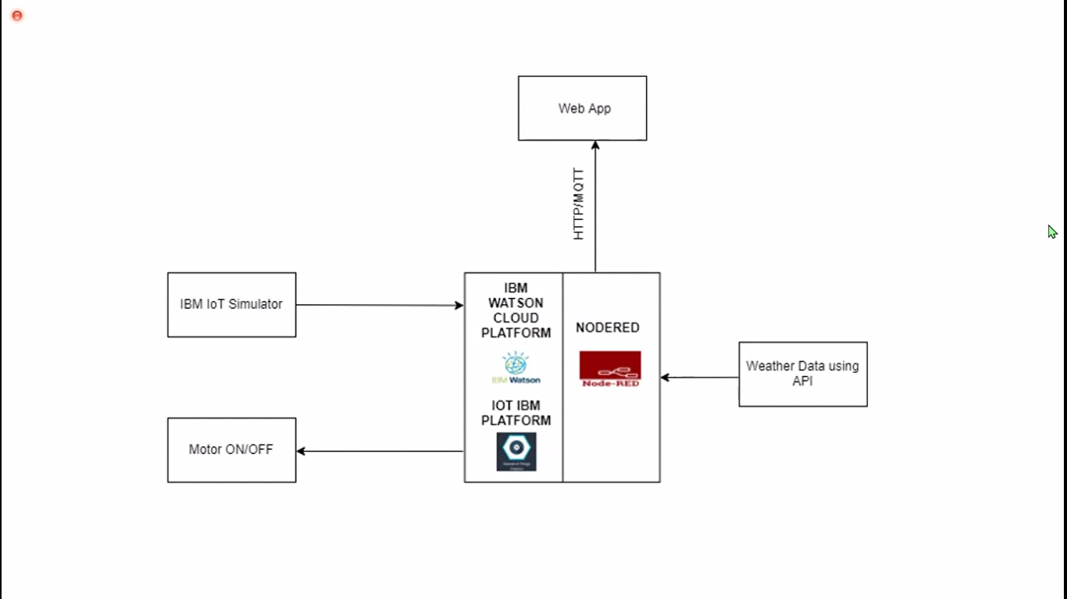
Block Diagram

Slide 4
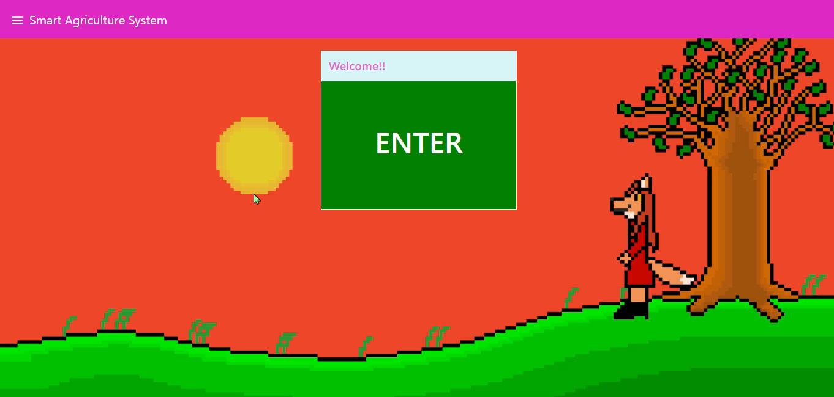
Web Application Tour

Slide 5

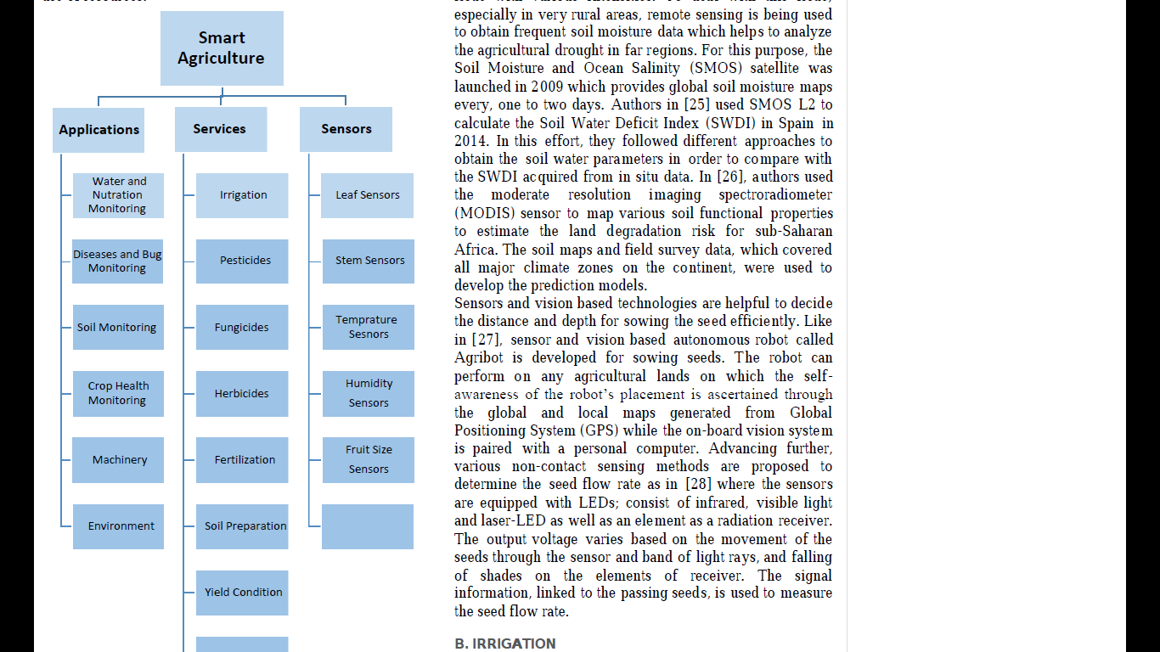
Future Scope
Future work would be focused more on increasing sensors on this system to fetch more data especially with regard to Pest Control and by also integrating GPS module in this system to enhance this Agriculture IoT Technology to full-fledged Agriculture Precision ready product.

Slide 6
Project content
Loading libraries and importing data
Exploratory data analysis
Data preprocessing
Model building
Logistic regression
Kneighbour classifier
Support vector classifier
Light gbm classifier

Slide 7
result
As a result the program using the code is detected and the graphical representation is done

